Slide 1
CIS387/ECE387
Digital Forensics I
Data Recovery and Graphics Files

Slide 2
Outline
Motivation
Disk Recovery Techniques
Graphical file recovering
  Types of graphics file formats
  Types of data compression
  How to locate and recover graphics files

Slide 3
Reasons for Data Recovery
Data loss or corruption due to
  Natural disaster
  System crash
  Malicious activity
  Error (human, hardware, or software)
Data recovery is needed when no other method to replace the data exists
Notes:
AWS can guarantee durability of your data at 99.9999999% (and even more decimal points if you pay more!)
Don’t mix this with availability → data may be durable (intact and usable and uncorrupted) but not available at the moment.

Slide 4
Data Recovery
Data recovery is the process of salvaging data from deleted, hidden or corrupted files or damaged media and return the data to an intact format
  Either to its original format and data structure
  Or to a standardized format
With data recovery, it is possible to:
  Retrieve deleted files and data
  Recover corrupted files
  Recover data from physically damaged devices
  …
Notes:
Big business in the 2000’s. No journaling done by file system so when system crashed the file system was inconsistent (allocation blocks and meta data, etc. not in syc).
But now file systems are much better and use journaling (NTFS, AFS, EXT) so the system can recover from a failed state to a consistent state.

Slide 5
Data Recovery Process
Identify files of interest
  Deleted files
  Hidden files
  Corrupted files
Determine in what time frame data has been lost and whether the system has been used recently or is still in use
  Stop system use until forensic actions are complete
Select technique to recover data
Use appropriate tools
  Restore data to original format

Slide 6
Outline
Motivation
Disk Recovery Techniques
Graphical file recovering
  Types of graphics file formats
  Types of data compression
  How to locate and recover graphics files

Slide 7
Disk Damage
Two main types of disk damage
  Physical damage
    Variety of failures can cause physical damage
    CDs: metallic substrate or dye layer scratched
    Hard disks: mechanical failures (head crash or failed motors)
  Logical damage
    Errors in file system which prevent the OS from mounting or using the file system
      Power outage, turning off a machine during booting or shutting down may cause logical damage
Notes:
Journaling (log files) helps a system to recover from logical damages.’

Slide 8
Physical Damage
Physical damage always causes data loss and damage in the file system’s logical structures
  Leads to logical damage
End users cannot repair most physical damage
  They don’t have the hardware and technical expertise
  Attempts to repair physical damage often increase the damage

Slide 9
Physical Damage Recovery Techniques
Recovering data from a hard drive should start with the assumption that the drive itself is still operable
Techniques to evaluate a “failed hard drive”
  Connect the drive to a test system that is functional
  Boot the test system from its own internal drive and listen to the failed drive to determine whether the internal disks are spinning
    Good sign if they are spinning
    If the hard drive is not spinning, perform limited repair
  Determine whether the failed drive is recognized and can be installed as an additional disk on the test system
    Copy data on the failed drive if it installs

Slide 10
Physical Damage Recovery Techniques (cont.)
Management may determine that there will be no increased loss if you attempt local repair and fail
Simple repair techniques for hard disk you may try (suppose they won’t void any disk drive warrants)
  Remove the printed circuit board and replace it with a matching circuit board from a known healthy drive
  Change the read/write head assembly with matching parts from a known healthy drive
  Remove the hard disk platters from the original drive and install them into a known healthy drive

Slide 11
Logical Damage to File System
More common than physical damage
  Incomplete file system structures written to the storage media due to power outages, improper power shut down, errors in hardware controllers, …
Prevent the host OS from mounting or using the file system
Can cause a variety of problems (i.e. system crashes), result in intermittent failures, trigger strange behaviors

Slide 12
Recovering Data After Logical Damage
Some programs can correct the inconsistencies that result from logical damage
Most OSs provide a basic repair tool for their native file systems
  MS chkdsk, Linux fsck, Mac OS X Disk Utility
Software developed to resolve logical file system errors
  The Sleuth Kit, TestDisk
Notes:
Journaling is much faster at rollback or commit when recovering from system crash and logical failure/damage; chkdsk and oother utilities are done at runtime and they take much longer to check for inconsistencies (could take an hour vs a few seconds from system reading log files when trying to recover at reboot).

Slide 13
Logical Damage Recovery Techniques
Consistency checking involves scanning a disk’s logical structure and ensuring that it is consistent with its specification
  chkdsk and fsck work in this fashion
  May fail if the file system is highly damaged
  Some tools may automatically delete data files if the files are out of place or unexplainable (could be problematic)
Zero-knowledge analysis
  Make few assumptions about the state of the file system and rebuild the system from scratch, using knowledge of an undamaged file system structure
  Usually much slower than consistency checking
  Helpful when the logical structure is almost completely damaged

Slide 14
Outline
Motivation
Disk Recovery Techniques
Graphical file recovering
  Types of graphics file formats
  Types of data compression
  How to locate and recover graphics files

Slide 15
Recognizing a Graphics File
Graphic files contain digital photographs, line art, three-dimensional images, and scanned replicas of printed pictures
  Bitmap images: collection of dots (pixel matrix)
  Vector graphics (much smaller storage size → trades space for time): based on mathematical instructions (which yields a pixel matrix in memory)
  Metafile graphics: combination of bitmap and vector
Types of programs
  Graphics editors
  Image viewers
Notes:
Vector Graphics allow for plotting (used for computer aided design) → “printing” or drawing an image actively showing the pixel image being drawn on a screen
Used in graphic design applications

Slide 16
Understanding Bitmap and Raster Images
Bitmap images
  Grids of individual pixels
Raster images - also collections of pixels
  Pixels are stored in rows (matrix)
  Better for printing
Image quality
  Screen resolution - determines amount of detail
  Software contributes to image quality (drivers)
  Number of color bits used per pixel (RGB = 1 byte per color = 3Bytes; remember, on fundamental pixel is composed of these 3 colors (via tiny LEDs).
Notes:
For image resolution: sometimes you may need to combine or divide one pixel(s) of a graphic file depending on the resolution being used for an output medium.

Slide 17
Understanding Vector Graphics
Characteristics of vector graphics
  Uses lines instead of dots
  Store only the calculations for drawing lines and shapes
  Smaller than bitmap files
  Preserve quality when image is enlarged
CorelDraw, Adobe Illustrator

Slide 18
Understanding Metafile Graphics
Metafile graphics combine raster and vector graphics
Example
  Scanned photo (bitmap) with text (vector)
Share advantages and disadvantages of both types
  When enlarged, bitmap part loses quality

Slide 19
Understanding Graphics File Formats
Standard bitmap file formats
  Portable Network Graphic (.png)
  Graphic Interchange Format (.gif)
  Joint Photographic Experts Group (.jpeg, .jpg)
  Tagged Image File Format (.tiff, .tif)
  Window Bitmap (.bmp) (no data loss)
Standard vector file formats
  Hewlett Packard Graphics Language (.hpgl)
  Autocad (.dxf)

Slide 20
Understanding Graphics File Formats
Nonstandard graphics file formats
  Targa (.tga)
  Raster Transfer Language (.rtl)
  Adobe Photoshop (.psd) and Illustrator (.ai)
  Freehand (.fh9)
  Scalable Vector Graphics (.svg)
  Paintbrush (.pcx)
Search the Web for software to manipulate unknown image formats

Slide 21
Understanding Digital Camera File Formats
Witnesses or suspects can create their own digital photos
Examining the raw file format
  Raw file format
    Referred to as a digital negative
    Typically found on many higher-end digital cameras
  Sensors in the digital camera simply record pixels on the camera’s memory card
  Raw format maintains the best picture quality
Notes:
RAW format = before compression.

Slide 22
Understanding Digital Camera File Formats
Examining the raw file format (cont’d)
  The biggest disadvantage is that it’s proprietary
    And not all image viewers can display these formats
  The process of converting raw picture data to another format is referred to as demosaicing
Examining the Exchangeable Image File format
  Exchangeable Image File (Exif) format
    Commonly used to store digital pictures
    Developed by JEITA as a standard for storing metadata in JPEG and TIF files
    Contains more meta data information besides the image itself

Slide 23
Understanding Digital Camera File Formats
Examining the Exchangeable Image File format (cont’d)
  Exif format collects metadata
    Investigators can learn more about the type of digital camera and the environment in which pictures were taken
  Viewing an Exif JPEG file’s metadata requires special programs
    Exif Reader, IrfanView, or ProDiscover
  Exif file stores metadata at the beginning of the file

Slide 24
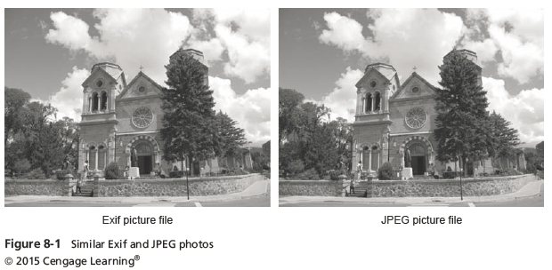
Understanding Digital Camera File Formats

Slide 25
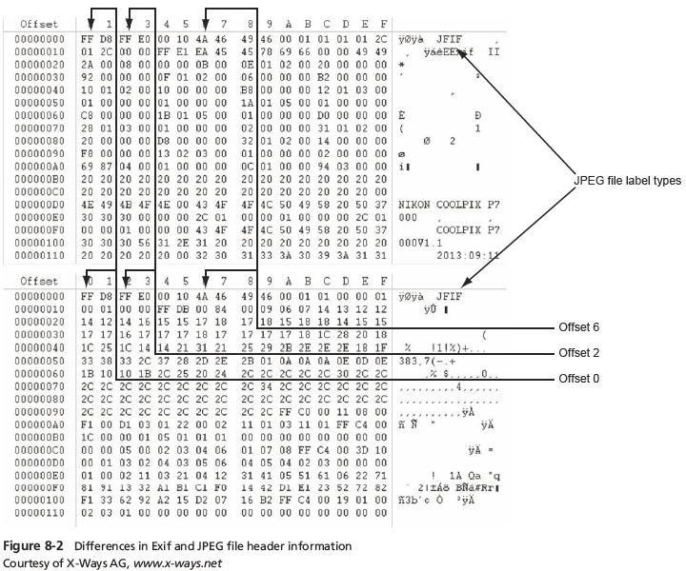
Understanding Digital Camera File Formats
FF E1
45 78 69 66 66c
Exif

Slide 26
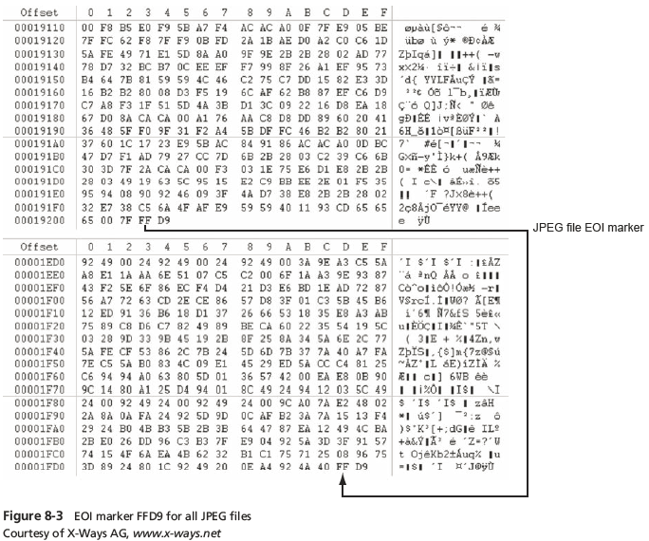
Understanding Digital Camera File Formats

Slide 27
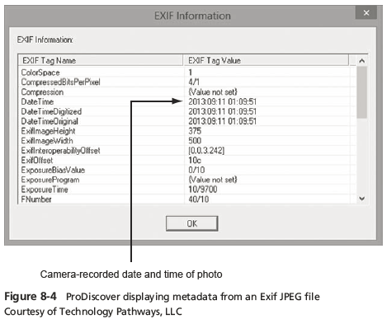
Understanding Digital Camera File Formats

Slide 28
Understanding Data Compression
Some image formats compress their data
  GIF and JPEG
Others, like BMP, do not compress their data
Data compression
  Coding data from a larger to a smaller form
  Types
    Lossless compression and lossy compression

Slide 29
Lossless and Lossy Compression
Lossless compression
  Reduces file size without removing data
  Based on Huffman or Lempel-Ziv-Welch coding
    For redundant bits of data
  Utilities: WinZip, PKZip, StuffIt, and FreeZip
Lossy compression
  Permanently discards bits of information
  Vector quantization (VQ)
    Determines what data to discard based on vectors in the graphics file
  Utility: Lzip

Slide 30
Locating and Recovering Graphics Files
Operating system tools
  Time consuming
  Results are difficult to verify
Digital forensics tools
  Image headers
    Compare them with good header samples
    Use header information to create a baseline analysis
  Reconstruct fragmented image files
    Identify data patterns and modified headers

Slide 31
Identifying Graphics File Fragments
Carving or salvaging
  Recovering any type of file fragments
Digital forensics tools
  Can carve from file slack and free space
  Help identify image files fragments and put them together

Slide 32
Repairing Damaged Headers
When examining recovered fragments from files in slack or free space
  You might find data that appears to be a header
If header data is partially overwritten, you must reconstruct the header to make it readable
  By comparing the hexadecimal values of known graphics file formats with the pattern of the file header you found

Slide 33
Repairing Damaged Headers
Each graphics file has a unique header value
Example:
  A JPEG file has the hexadecimal header value FFD8, followed by the label JFIF for a standard JPEG or Exif file at offset 6

Slide 34
Identifying Unknown File Formats
Knowing the purpose of each format and how it stores data is part of the investigation process
The Internet is the best source
  Search engines like Google
  Find explanations and viewers
Popular Web sites
  www.fileformat.info/format/all.htm
  http://extension.informer.com
  www.martinreddy.net/gfxl

Slide 35
Analyzing Graphics File Headers
Necessary when you find files your tools do not recognize
Use a hexadecimal editor such as WinHex
  Record hexadecimal values in the header and use them to define a file type
Example:
  XIF file format is old, little information is available
  The first 3 bytes of an XIF file are the same as a TIF file
  Build your own header search string

Slide 36
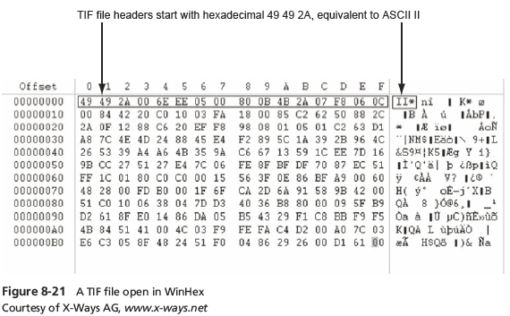
Analyzing Graphics File Headers

Slide 37
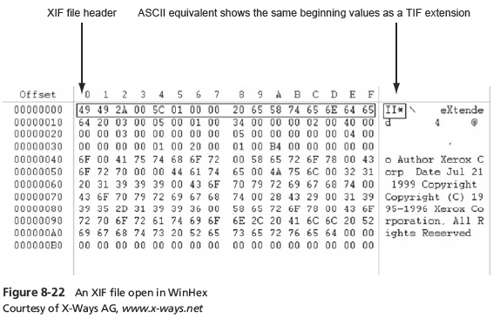
Analyzing Graphics File Headers

Slide 38
Tools for Viewing Images
After recovering a graphics file
  Use an image viewer to open and view it
No one viewer program can read every file format
  Having many different viewer programs is best
Most GUI forensics tools include image viewers that display common image formats
Be sure to analyze, identify, and inspect every unknown file on a drive

Slide 39
Understanding Steganography in Graphics Files
Steganography hides information inside image files
  An ancient technique
Two major forms: insertion and substitution
Insertion
  Hidden data is not displayed when viewing host file in its associated program
    You need to analyze the data structure carefully
  Example: Web page

Slide 40
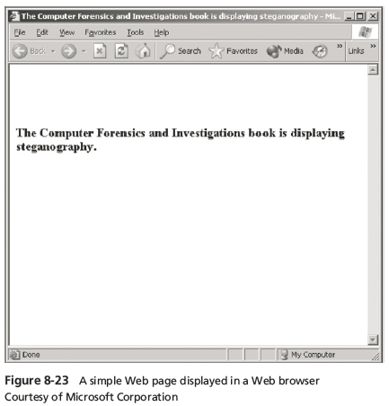
Understanding Steganography in Graphics Files

Slide 41
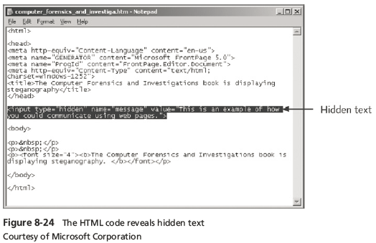
Understanding Steganography in Graphics Files
Notes:
Hidden text will not be shown on web browser application used to read the HTML source code file (mainly used for the server to keep track of things that the user does not need to know about); so you need to look at the source code (in this case since HTML code file is in plaintext) to see the hidden message; some hidden message requires a special tool that is not the regular application that reads the file in order to find and read the hidden data.

Slide 42
Understanding Steganography in Graphics Files
Substitution
  Replaces bits of the host file with other bits of data
  Usually change the last two LSBs (least significant bit)
  Detected with steganalysis tools (a.k.a - steg tools)
You should inspect all files for evidence of steganography
Clues to look for:
  Duplicate files with different hash values
  Steganography programs installed on suspect’s drive

Slide 43
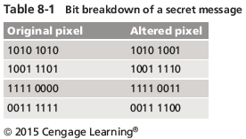
Understanding Steganography in Graphics Files
Notes:
Since LSBs are changed, no noticeable changes to output of graphic file is apparent; since image files are composed of so much data, you can combine all of the changed LSBs to form a message!
You can even encrypt the message first, then add the encrypted bits to the LSBs of each pixel (into as many pixels as needed to hold the hidden and encrypted message/data).

Slide 44
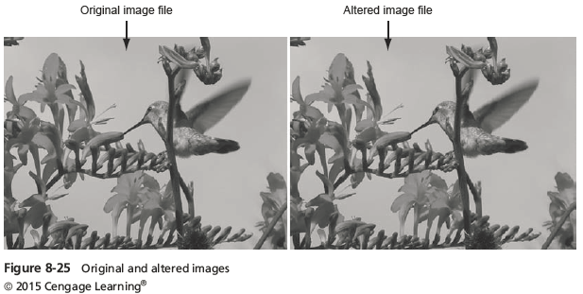
Understanding Steganography in Graphics Files

Slide 45
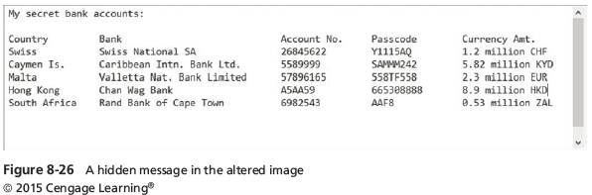
Understanding Steganography in Graphics Files

Slide 46
Using Steganalysis Tools
Use steg tools to detect, decode, and record hidden data
Detect variations of the graphic image
  When applied correctly you cannot detect hidden data in most cases
Check to see whether the file size, image quality, or file extensions have changed

Slide 47
Understanding Copyright Issues with Graphics
Steganography has been used to protect copyrighted material
  By inserting digital watermarks into a file
Digital investigators need to aware of copyright laws
Copyright laws for Internet are not clear
  There is no international copyright law
Check www.copyright.gov
  U.S. Copyright Office identifies what can and can’t be covered under copyright law in U.S.

Slide 48
Summary
Three types of graphics files
  Bitmap
  Vector
  Metafile
Image quality depends on various factors
Standard file formats: .gif, .jpeg, .bmp, and .tif
Nonstandard file formats: .tga, .rtl, .psd, and .svg
Some image formats compress their data
  Lossless compression
  Lossy compression
Notes:
GPU can decompress compressed graphic files much faster than if you only have a CPU.

Slide 49
Summary
Digital camera photos are typically in raw and EXIF JPEG formats
Recovering image files
  Carving file fragments
  Rebuilding image headers
The Internet is best for learning more about file formats and their extensions
Software
  Image editors
  Image viewers

Slide 50
Summary
Steganography
  Hides information inside image files
  Forms
    Insertion
    Substitution
Steganalysis
  Finds whether image files hide information

